Slide 1
These Steps are also on my YouTube Channel
https://youtu.be/6LCYam-GgjE
Step-by-step instructions to:
1) Download and install OpenJDK
2) Unzip OpenJDK onto your hard drive
3) Set your system path so java.exe and javac.exe are found
4) Install VS Code and the Java Extension Pack to run Java from your IDE.

Slide 2
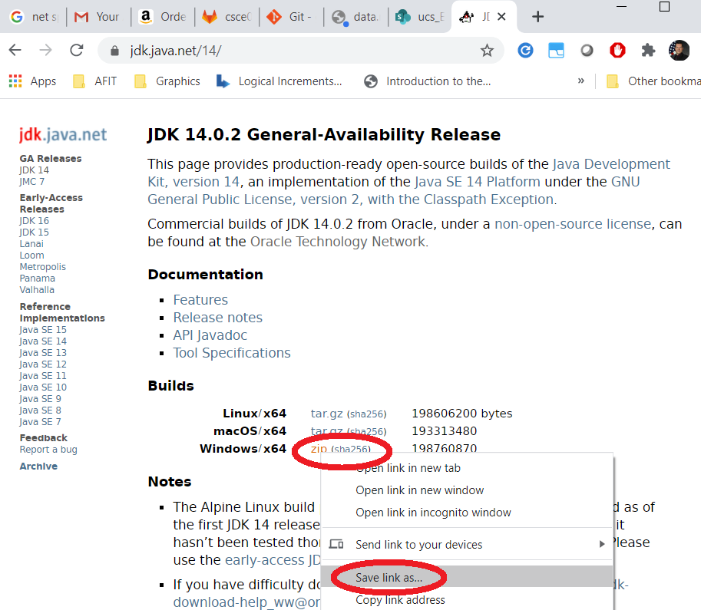
Download and install Java JDK (Java Compiler + Java Runtime)
https://jdk.java.net/ (Use latest “Release / Ready for use version”)

Slide 3
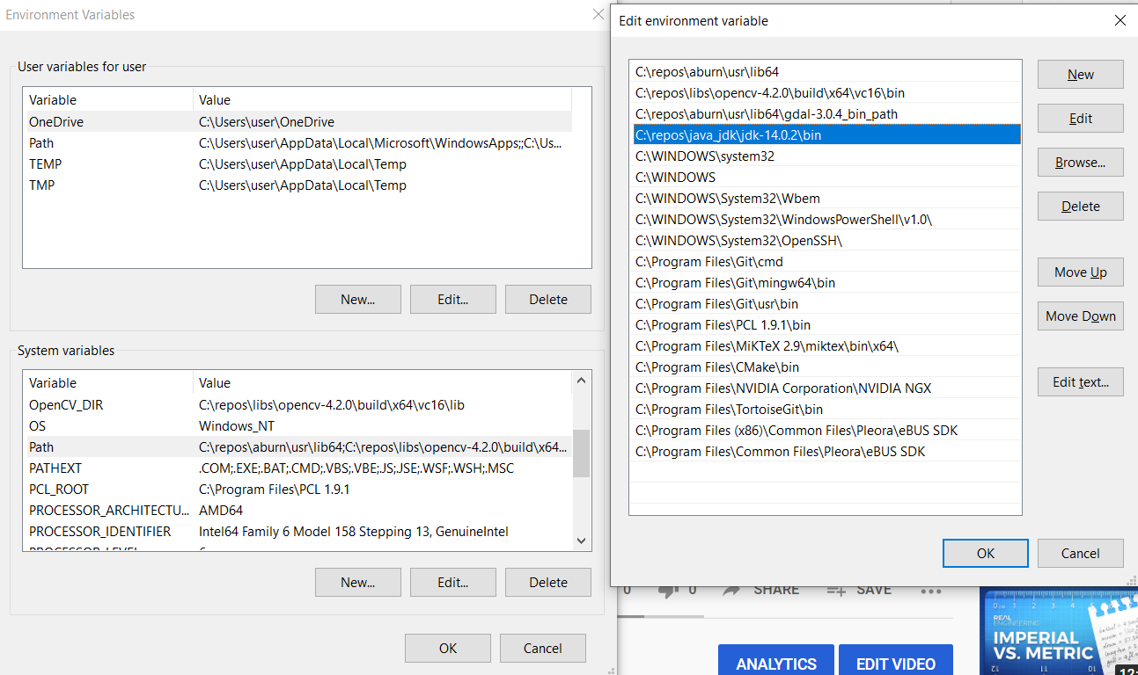
After installing the JDK, we need to add the binaries into the environment’s path
I Choose to extract the .zip file to C:\repos\java_jdk\
C:\repos\java_jdk\jdk-14.0.2\bin

Slide 4
Test path works properly, open a *new*
Open an command window and type “javac” (java compiler)
C:\Users\user>javac
Usage: javac <options> <source files>
where possible options include:
Javac was found! We’re ready to code.
If you see “command not found”, the path was not entered properly, or you did not close and reopen your command window so the new setting can take effect.

Slide 5
Now download our Editor – VS Code
Download and install VS Code (Win + OS X + Linux)
https://code.visualstudio.com/download

Slide 6
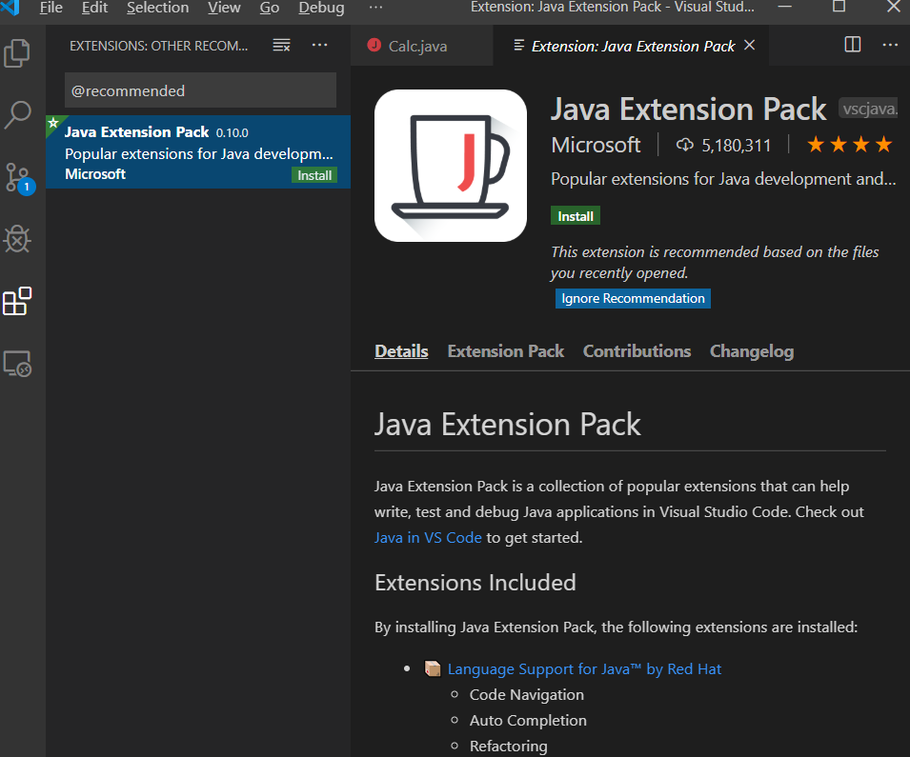
Install the Java Language Support Plugin for VS Code
In the Extensions bar (Crtl – Shift – X) search for “Java”
Choose “Java Extension Pack”, Click Install

